Slide 1
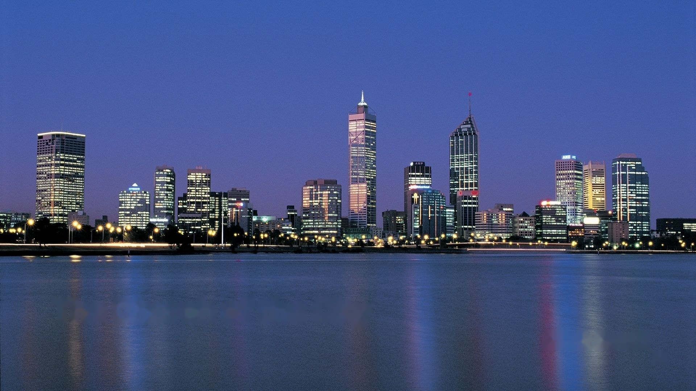
The Church of the City
Nick Scott
1

Slide 2
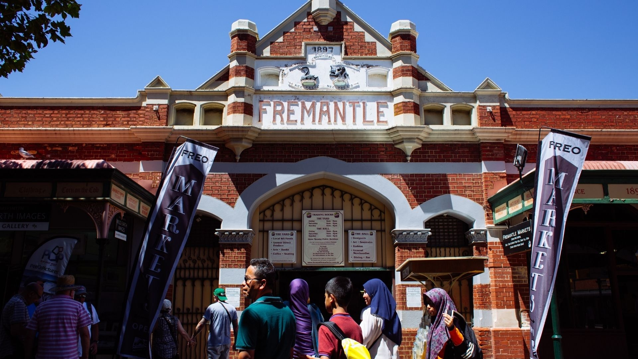

Slide 3
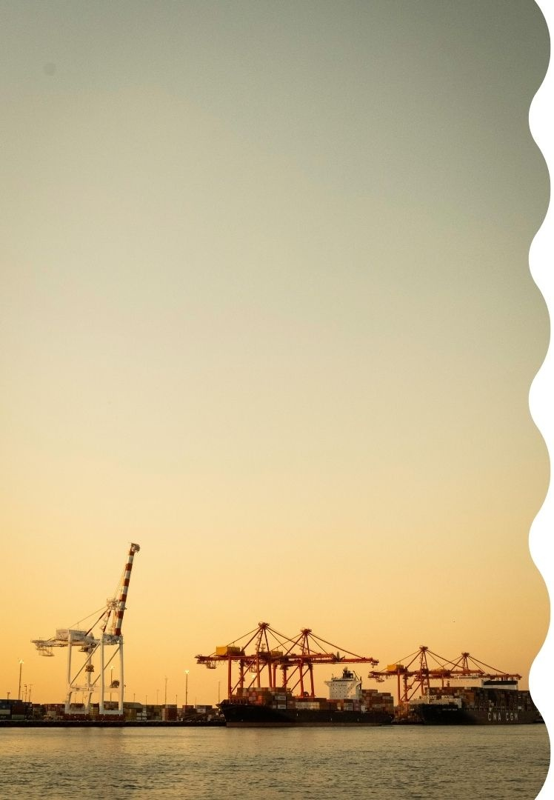
Jesus’ prayer is that we might be one!
“Then the world will know that you have sent me and have loved them even as you have loved me.”

Slide 4
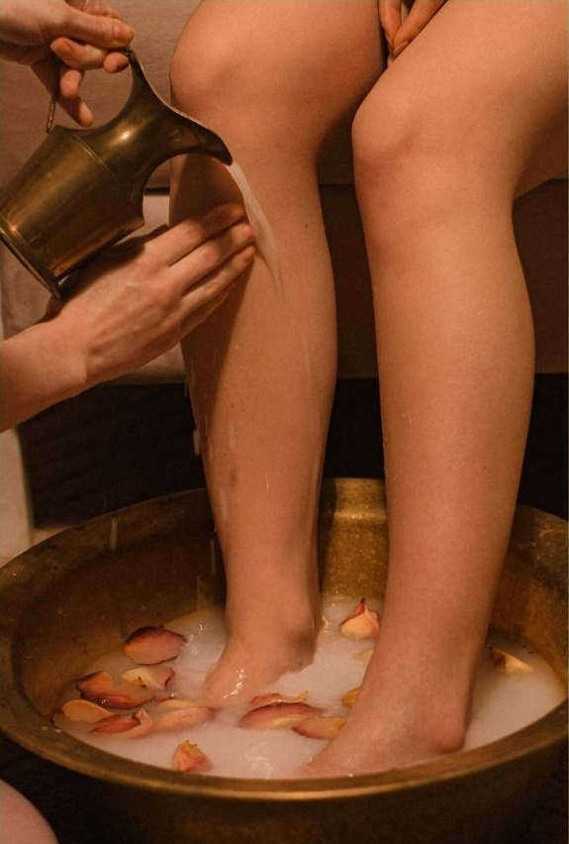
What does this unity look like?
Unity has a posture of humility

Slide 5
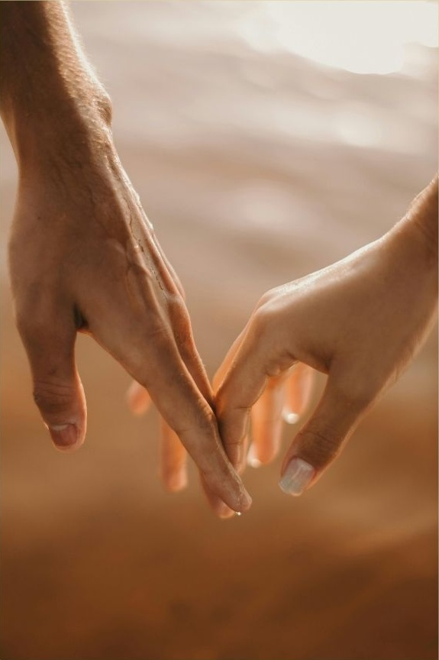
What does this unity look like?
Unity has a posture of humility
Unity has a currency of love

Slide 6

What does this unity look like?
Unity has a posture of humility
Unity has a currency of love
Unity has the effect of healing

